Slide 1
PARKING MANAGEMENT SYSTEM USING PHYTHON & SQL by
Manasa Kumari Varkala

Slide 2
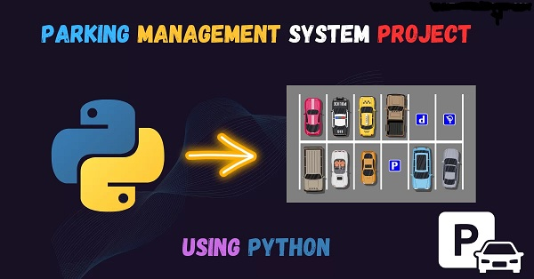

Slide 3
The output and receipt generated for Parking Management system
using Phython
Enter vehicle number: ts103
Select vehicle type:
1. Bike
2. Car
3. Truck
4. Physically disabled
Enter choice (1-4): 1
Enter user contact number: 99841324
Enter entry time in YYYY-MM-DD HH:MM:SS format: 2023-04-23 22:15:00
Enter exit time in YYYY-MM-DD HH:MM:SS format: 2023-04-23 23:15:00
--------------- Receipt ---------------
Vehicle Number: ts103
Vehicle Type: Bike
Contact Number: 99841324
Parking Ticket Number: MAPMCIH0
Entry Time: 2023-04-23 22:15:00
Exit Time: 2023-04-23 23:15:00
Duration: 1:00:00
Total Cost: 10.0 USD
---------------------------------------

Slide 4
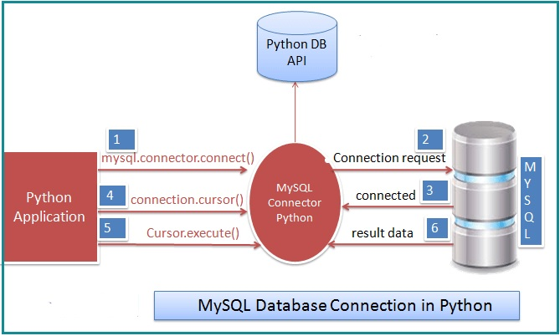

Slide 5
Automated parking records in SQL from Phython
vehicle_number | vehicle_type | contact_number | ticket_number | entry_time | exit_time | total_cost
vehicle_number | Car | 9.88E+09 | A1B2C3D4 | 1/1/2022 9:00 | 1/1/2022 10:30 | 15
vehicle_number | Bike | 1.23E+09 | E5F6G7H8 | 1/1/2022 10:00 | 1/1/2022 11:30 | 10
GHI789 | Truck | 1E+10 | I9J8K7L6 | 1/1/2022 11:00 | 1/1/2022 13:30 | 30
JKL012 | Physically disabled | 1.11E+09 | M0N1O2P3 | 1/1/2022 12:00 | 1/1/2022 14:30 | 20
MNO345 | Car | 2.22E+09 | Q4R5S6T7 | 1/1/2022 13:00 | 1/1/2022 15:30 | 20
PQR678 | Bike | 3.33E+09 | U8V9W0X1 | 1/1/2022 14:00 | 1/1/2022 16:30 | 15
STU901 | Truck | 4.44E+09 | Y2Z3A4B5 | 1/1/2022 15:00 | 1/1/2022 18:30 | 45
VWX234 | Physically disabled | 5.56E+09 | C6D7E8F9 | 1/1/2022 16:00 | 1/1/2022 19:30 | 30
YZA567 | Car | 6.67E+09 | G0H1I2J3 | 1/1/2022 17:00 | 1/1/2022 20:30 | 30
BCD890 | Bike | 7.78E+09 | K4L5M6N7 | 1/1/2022 18:00 | 1/1/2022 21:30 | 25
EFG123 | Truck | 8.89E+09 | O8P9Q0R1 | 1/1/2022 19:00 | 1/1/2022 23:30 | 60
HIJ456 | Physically disabled | 1E+10 | S2T3U4V5 | 1/1/2022 20:00 | 1/2/2022 1:30 | 45
ts-40 bQ-1254 | Car | 1E+10 | 9SVVGU9V | 1/1/2022 14:00 | 1/1/2022 15:00 | NULL
ABC123 | Car | 9.88E+09 | A1B2C3D4 | 1/1/2022 9:00 | 1/1/2022 10:30 | 15
DEF456 | Bike | 1.23E+09 | E5F6G7H8 | 1/1/2022 10:00 | 1/1/2022 11:30 | 10
GHI789 | Truck | 1E+10 | I9J8K7L6 | 1/1/2022 11:00 | 1/1/2022 13:30 | 30
JKL012 | Physically disabled | 1.11E+09 | M0N1O2P3 | 1/1/2022 12:00 | 1/1/2022 14:30 | 20
MNO345 | Car | 2.22E+09 | Q4R5S6T7 | 1/1/2022 13:00 | 1/1/2022 15:30 | 20
PQR678 | Bike | 3.33E+09 | U8V9W0X1 | 1/1/2022 14:00 | 1/1/2022 16:30 | 15
STU901 | Truck | 4.44E+09 | Y2Z3A4B5 | 1/1/2022 15:00 | 1/1/2022 18:30 | 45

Slide 6
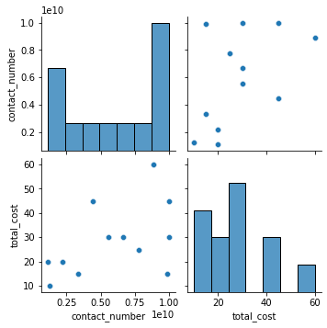
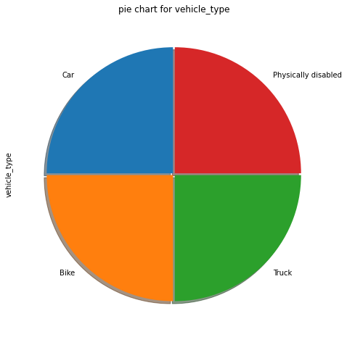
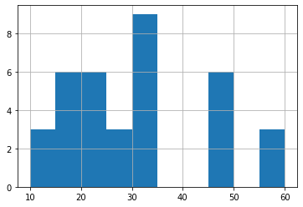
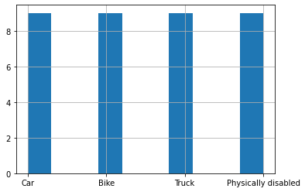
Data visualization done by importingpandas,Numpy,Matplotlib & Seaborn

Slide 7
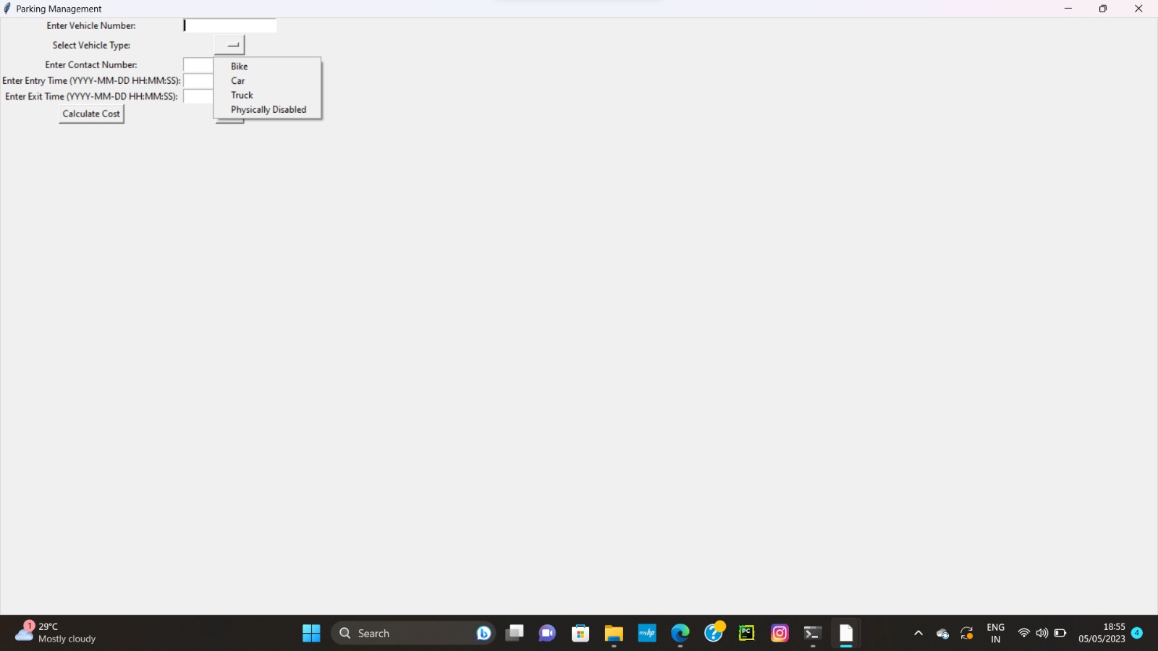
User Interface

Slide 8
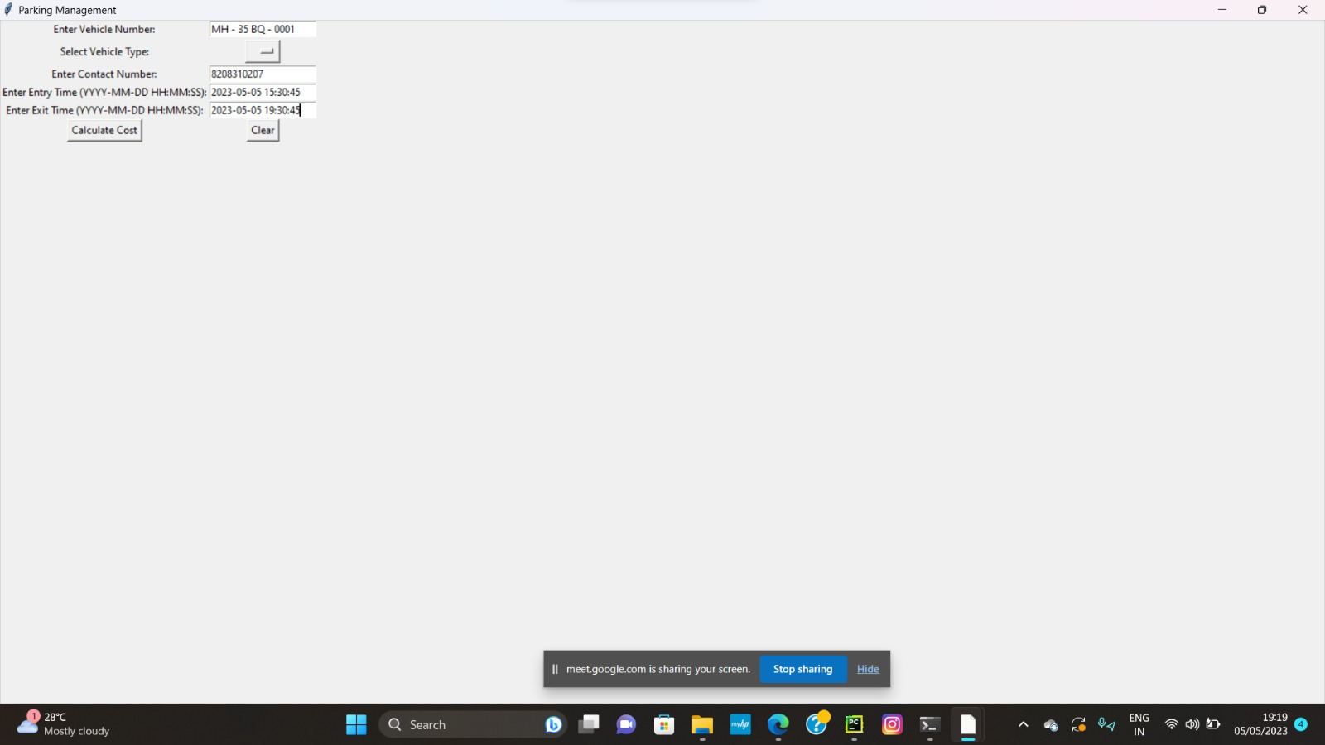

Slide 9
SUMMARY OF OUR PROJECT PARKING MANAGEMENT SYSTEM
Firstly we imported modules like datetime, random, string, and pymysql.The datetime module is used to manage date and time information. Random and string modules are used to generate random ticket numbers. The pymysql module is used to connect to and communicate with a MySQL database.
Next, the class 'Vehicle' is defined, which takes in six arguments - vehicle_number, vehicle_type, contact_number, ticket_number, entry_time, and exit_time. The constructor initializes the class attributes with the corresponding values.
The class also includes two methods - 'get_duration'and 'get_cost'. The 'get_duration' method calculates the duration of the parking and returns it. The 'get_cost' method calculates the parking cost based on the duration and returns it.
The 'print_receipt' method prints the parking receipt containing vehicle details, entry and exit time, duration, and the total cost.
After the class definition, the code connects to a MySQL database using pymysql and prompts the user to enter vehicle details such as vehicle number, type, contact number, entry, and exit time.
It generates a random ticket number using the string and random modules and creates a Vehicle object using the user-entered details. It then calls the 'print_receipt' method to display the parking receipt.
The code then inserts the parking record into the MySQL database using an SQL query and commits the changes. Finally, the connection to the database is closed.

Slide 10


